Slide 1

Customer Discovery
WEEK FIVE
CEO: Rachel Evans
CTO: Sophie Tanker
CFO: Andra Buchan

Slide 2
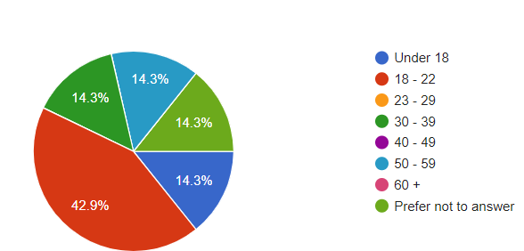
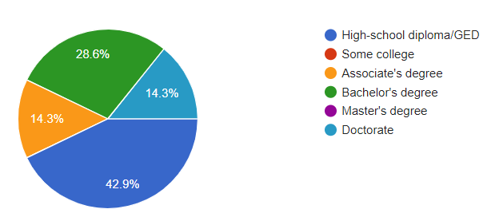
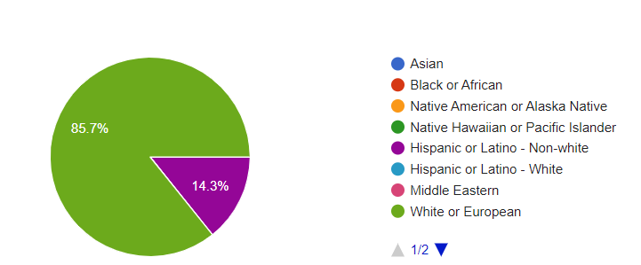
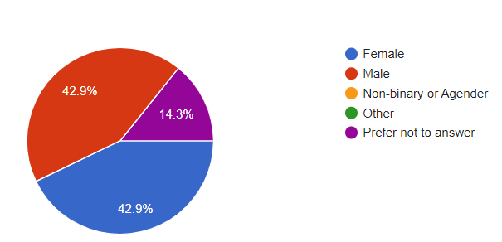
DEMOGRAPHIC INFORMATION

Slide 3

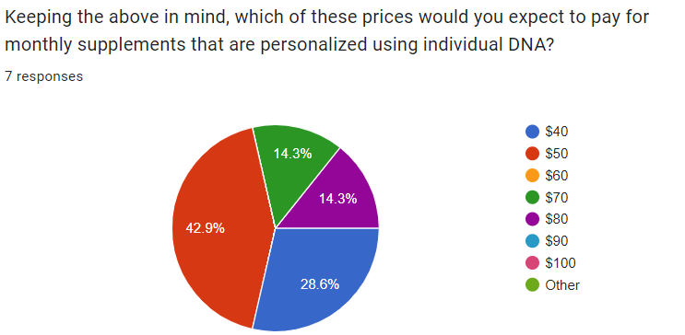
MONTHLY PRICE POINT

Slide 4
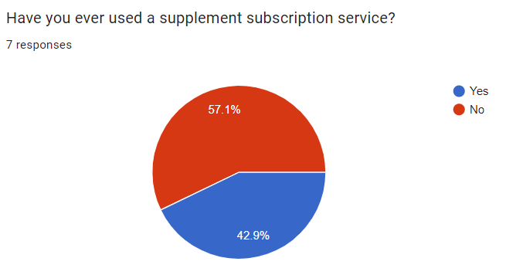
HAVE YOU STOPPED SUPPLEMENTS?

Slide 5
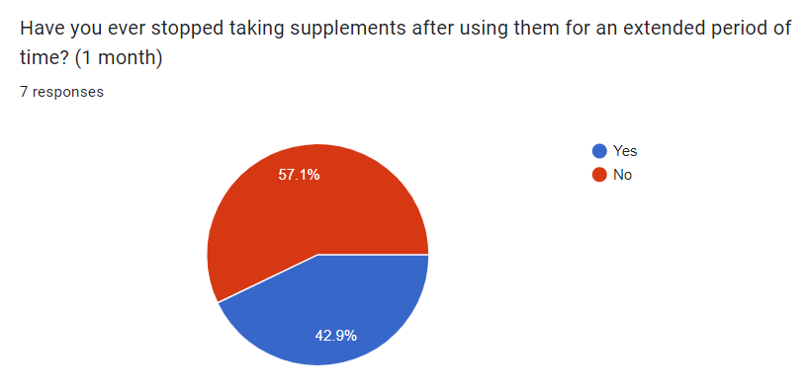
HAVE YOU STOPPED SUPPLEMENTS?

Slide 6
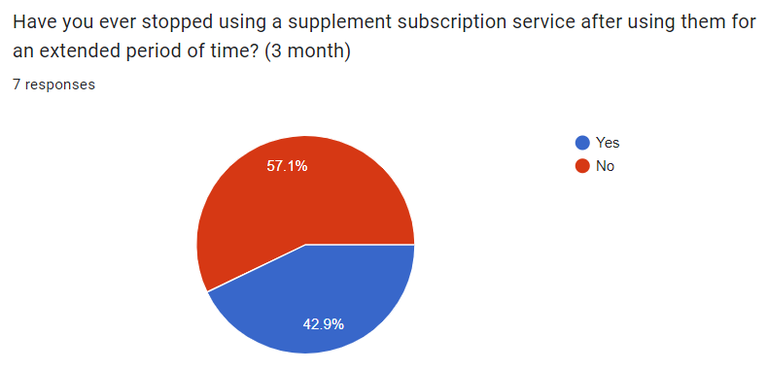
HAVE YOU STOPPED SUPPLEMENTS?

Slide 7
TAKEAWAYS
Why did you stop using supplements/supplement subscription services?
Expensive
Every doctor I've ever heard talk on the subject has said supplements are useless unless a doctor specifically tells you that you need them. Most people do not.
No longer needed them
Results are not immediate so concerns of cost-based effectiveness is questioned.
Out of the seven surveyed, three had used supplement subscription services. All three discontinued their subscription.

Slide 8
COMMENTS
I think with the right publicity, this could go big. Lots of people need stuff like this but aren’t exactly sure what they need, but with this it could help with that. These are my opinions.
Stuff like this prays on peoples health concerns for profit while providing no real health benefit.
90 day trial money back guarantee

Slide 9
Questions?

